Slide 1
Basic NVivo and Doing Qualitative Research: Interview Analysis and Literature Reviews
Andrew R. Smolski
Department of Sociology and Anthropology
arsmolsk@ncsu.edu

Slide 2
Write-to-Think Exercise
To begin with, take out a pen and paper. Or, you can use your computer if you like.
What do you think NVivo can do? How do you think NVivo supports the qualitative research process?
Take a few minutes to think about these questions. Then, we will share together.

Slide 3
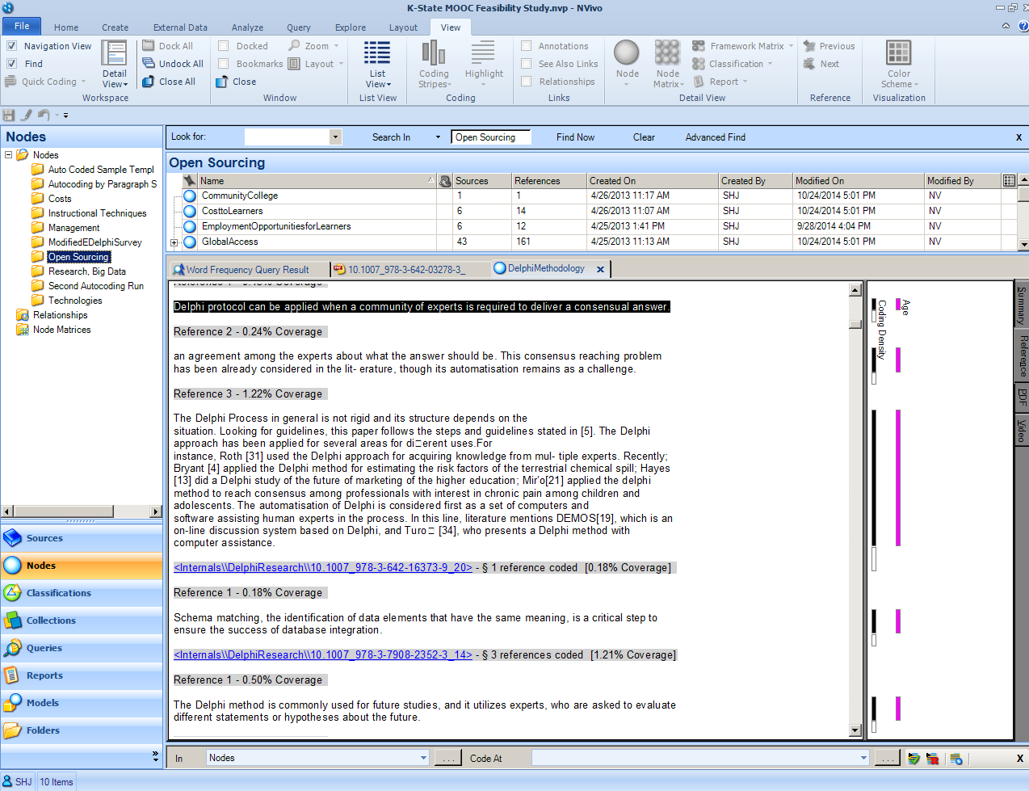

Re-Cap: Types of qualitative methods
In-depth interviews
Data – Transcribed and coded interviews
Content Analysis
Data – Newspapers, magazines, flyers, etc.
Ethnography
Data – field observations, participation, etc.

Slide 4
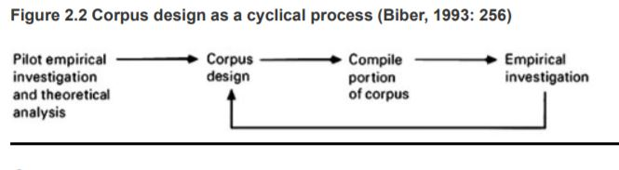
Re-Cap Qualitative Data
Corpus – This is the name of a qualitative database
Qualitative data is primarily text
Systematically collected as opposed to random sampling
Selection for representativeness
Saturation across a target population

Slide 5
Re-Cap: Coding Qualitative Data
Open Coding
- Details
- Theoretical Notes
- As many codes as you feel represent different aspects of the data
Focused Coding
- Refine and reduce the number of codes
- Which codes overlap or analyze a similar phenomena
Frames
- Array codes into groups

Slide 6
Basic Definitions for NVivo
Codes
Code Selection – Allows for coding a highlighted portion with one to multiple codes
Code In Vivo – Turns the highlighted portion into a code
Matrix Coding Query – Build tables to analyze where data is coded with multiple codes
Notes
Memos – A function to take notes on your coding activity, matrix development, and diagram construction

Slide 7
Basic Definitions for NVivo - Continued
Visualizing
Word Cloud – a graphic image of the dominant words used in the corpus, can be used for coding Nvivo
Hierarchy Chart – a graphic representation of the corpus and its codes, both for exploratory and analytical purposes
Cluster Analysis – develops dendograms, and other visualizations, of clustering based on correlation coefficients

Slide 8
Workshop Activity
On the GitHub for this workshop, there is a file that contains an interview. We are going to use this interview for coding and thinking about frames arising from the data.

Slide 9
Analyzing and Annotating for Literature Review
Focus on main points
Depending on purpose:
Document theory
Document methods
Document results
Build a coding system

Slide 10
More than Summarization, Synthesis
Summarizing
Represent the author’s argument, not a strawman
Present the main points without oversimplifying
Synthesizing
Fitting parts together to build a cohesive, whole
Novelty of the synthesis

Slide 11
Example: Environmental Sociology
Synthesis: Into theoretical mechanisms, agents/organizations involved, outcomes
Frameworks | Mechanisms | Outcomes
Reflexive Modernity | Technological Innovation Commodification (+) Institutional Reflexivity | Reducing Ecological Risk Risk Universalization
Critical Political Economy | Techno-Fix Commodification (-) Anti-Reflexivity | Increasing Ecological Risk Risk Stratification

Slide 12
Workshop Activity
On the GitHub for this workshop, there is a file that contains a set of annotations. We are going to use these annotations to model how NVivo supports literature reviews.

Slide 13
Workshop Feedback
If you are able, I would appreciate feedback to help improve this workshop in the future. Please, go to this link to comment: http://go.ncsu.edu/pseval
Thanks for your participation today!

